Slide 1

Mobile Application Development
Welcome
Class: BS(CS)-VII
Sukkur IBA University – Kandhkot Campus
Week - 09
Lecture – 17
Your Facilitator, Adil Khan

Slide 2
Text-to-Speech

Slide 3
Text-to-Speech
Text-to-speech allows Android device to speak an audible message based on a text string.
Not installed by default on some devices. To install, click Settings → Language and Input → Text to speech output → Google text-to-speech engine "settings" icon → Install voice data → Languages
In general, text-to-speech on Android is simple:
create an object of TextToSpeech class
call its speak() method

Slide 4
TextToSpeech class
Constructor and methods
new TextToSpeech(activity, listener) – constructor
getVoice, getVoices, setVoice – get/change the speaking voice
getLanguage, setLanguage – gets/sets the language used
getPitch, setPitch – gets/sets the vocal tone used
isSpeaking - returns true if speaking
shutdown - kills TTS engine
speak(text, mode, params) - speaks given text aloud
stop - halts any speech

Slide 5
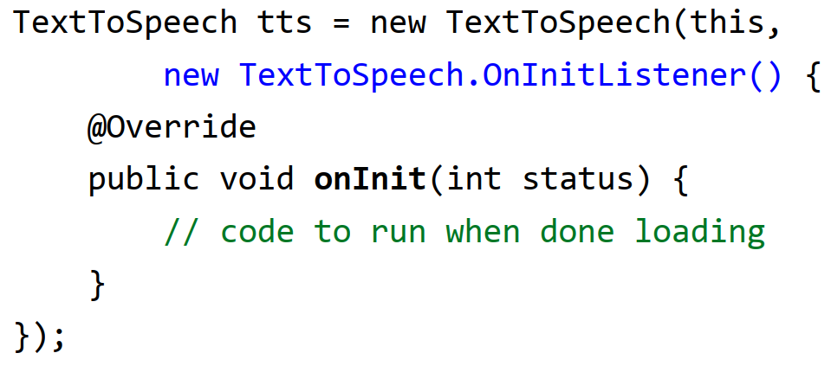
Initialization and listener
The TextToSpeech service can take a while to initialize.
Therefore, its constructor forces you to pass a listener object.
The listener will be notified when the TTS service is done loading.
This helps keep the main UI from freezing up during TTS load time.

Slide 6
Initialization and listener
You must wait until the text-to-speech listener's onInit() method has been called before trying to speak any text.
Otherwise the app will crash with an exception.
So, typically you should
create a boolean flag in your activity
have your listener set it to true when the initialization is complete
only call speak() on the TTS object if the flag is set to true

Slide 7
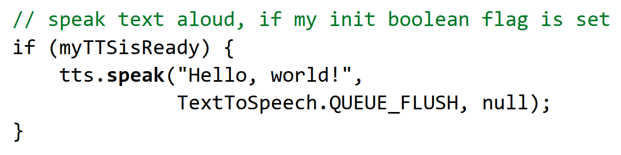
Initialization and listener
The speak method accepts three parameters
the text to speak aloud, as a String
the mode to use for speaking, either of the followings:
TextToSpeech.QUEUE_ADD : Speak after any other text is done.
TextToSpeech.QUEUE_FLUSH : Stop any other text and speak immediately.
a HashMap of parameters (usually, we pass null).

Slide 8
Thank you!
Any Questions???

